Slide 1
Walla Walla Valley Wineries (WWV)
Mateus Conaway and Kaylah Tan

Slide 2
Problem Statement
Walla Walla is known for their wines and many people come here for wine tasting so…
Design a database for tourist visiting Walla Walla
Specific regions: Airport District, Downtown Walla Walla, Oregon Valley
Potential users: tourists coming or leaving WW, Whitman students/faculty/staff/parents, residents, etc.

Slide 3
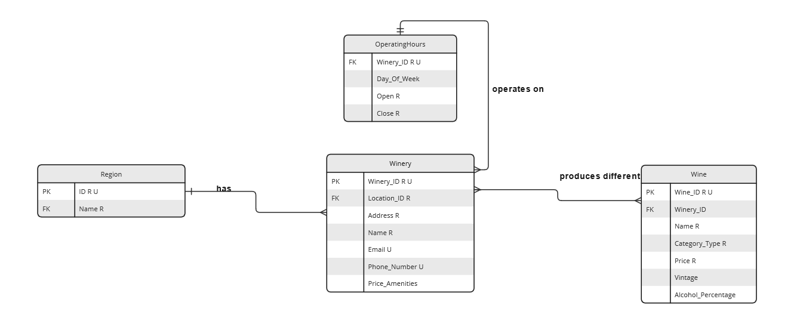
E-R Diagram

Slide 4
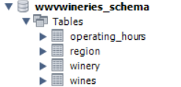
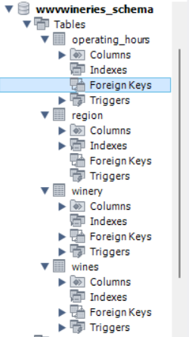
MySQL Workbench

